Slide 1

HOSPITAL PATIENT CARE OPERATIONS ANALYTICS
MySQL Project
Presented by
Kalagadandu Venkata Rao

Slide 2
ABOUT ME
KALAGADANDU VENKATA RAO
Background: POST Graduation [MBA]
Work Experience: Fresher
LinkedIn: https://www.linkedin.com/in/kalagadandu-venkata-rao-82216a334/
GitHub:-https://github.com/Venkatkalaga

Slide 3
Agenda
Project Overview
Project Objective
Dataset & Database Overview
ER Diagram & Database Structure
SQL Analysis & Business Questions
Key Insights & Findings
Challenges Faced in the Project
Conclusion & Recommendation

Slide 4
Project Overview
The project contains data about Doctors, patients, rooms, appointments, and Treatments
We analyzed Appointment trends, service types and priorities and booking channel
We studied patient behavior ,patient types , preferred time slots, and doctor performance.
We analyzed room usage, equipment types, treatment duration, waiting time and treatment costs.
We evaluated treatment status ,treatment performance , estimated costs
Actual treatment costs to identify areas where hospital operations and resource utilization can be improved

Slide 5
Project Objective
A hospital manages how efficiently hospital services and resources are being utilized.
They need to know patient preferences, appointment patterns, service types, factors affecting treatment experience.
The hospital wants to identify high-demand services, frequently used rooms and areas with lower performance.
Management also wants to identify issues such as high waiting time, long treatment duration, treatment status, and cost variations to improve overall hospital efficiency and patient service.

Slide 6
Dataset & Database Overview
Table | ROWS | COLUMNS
patients | 400 | 8
appointments | 3000 | 8
treatments | 3500 | 10
doctors | 80 | 7
rooms | 50 | 7

Slide 7
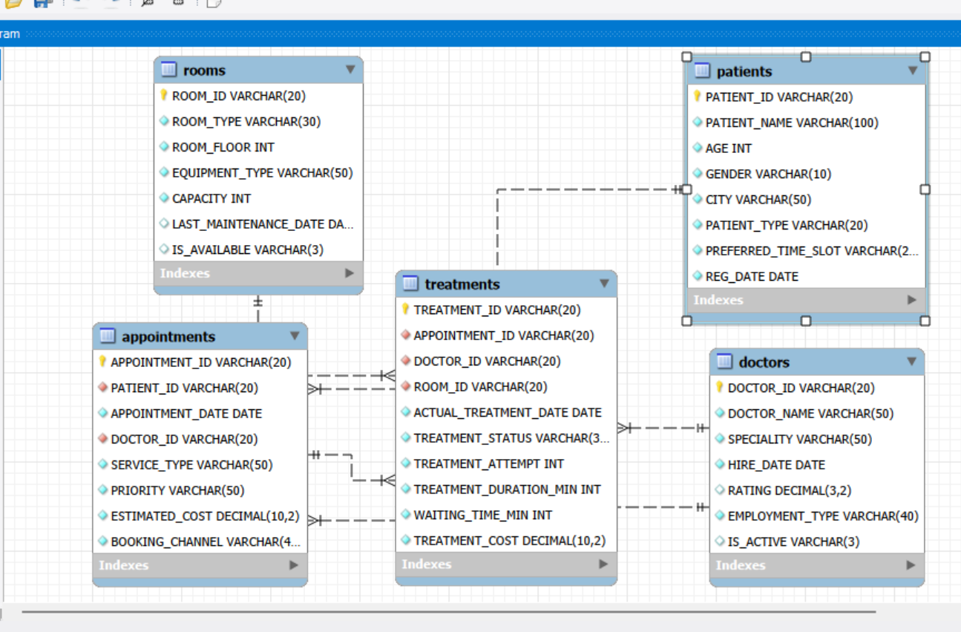
ER Diagram & Database Structure

Slide 8
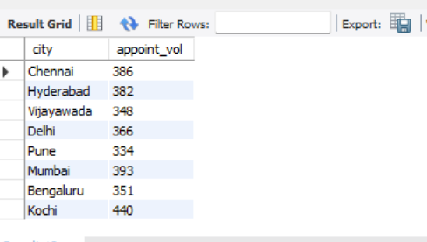
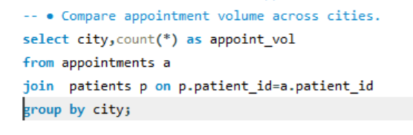
SQL Analysis & Business Questions
Objective based analysis ?
Key Insights:
Joined appointments and patients using patient_id to get the city for each appointment
Use count and group by to compare appointment and identify cities with higher demand to lower demand cities.

Slide 9
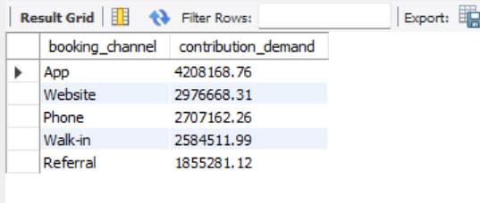
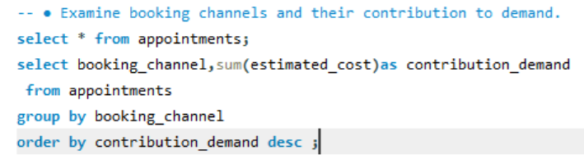
Examine booking channels and their contribution to demand?
Key Insights:
Use appointments and grouped appointments table by booking channel to generate most appointments
Used count(*) to measure demand to each booking channel to over all appointments volume

Slide 10
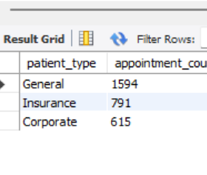
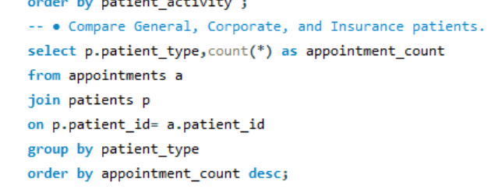
compare general,corporate,and insurance ?
Key Insights:
.joined appointments and patients using patient_id to compare appointments counts for general,corporate and insurance
Used count and group by to identify which patient_type contribute highest and lowest appointment demand.

Slide 11
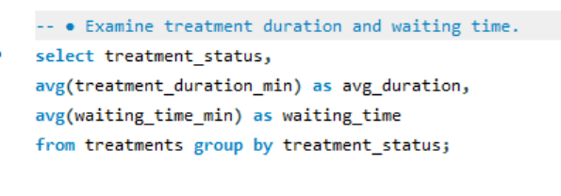
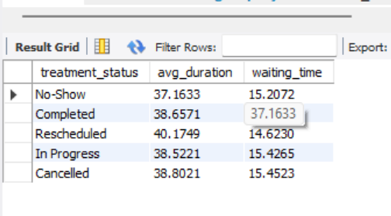
Examine treatment duration and waiting time ?
Key Insights:
Calculated average treatment duration and average waiting time for each treatment_status.
This helps identify which treatment status have taken longer treatment times and longer waiting times.

Slide 12
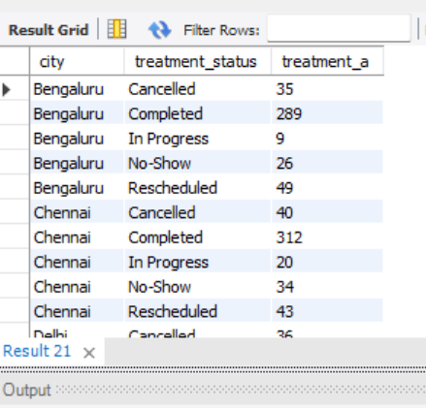
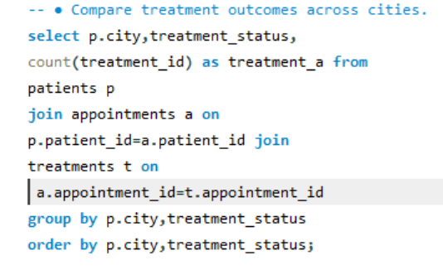
Compare treatment outcomes ?
Key Insights:
Joined PATIENTS, APPOINTMENTS, and TREATMENTS to compare treatment outcomes across different cities based on the patient's city.
Used COUNT and GROUP BY to calculate the number of treatments for each treatment status in every city, helping identify better and lower treatment outcomes by location

Slide 13
Key Insights & Findings
Appointment demand varies across cities, helping identify locations with higher and lower patient demand.
Booking channels contribute differently to appointment volume, showing which channels are more effective in generating appointments.
General, Corporate, and Insurance patients show different appointment patterns, helping understand the major patient segments.
Treatment duration and waiting time vary by treatment status, highlighting areas where hospital efficiency can be improved.
Treatment outcomes differ across cities, helping management identify locations with stronger performance and areas that may need improvement.
Room and equipment utilization can be evaluated to support better allocation of hospital resources.
Treatment costs and estimated appointment costs can be compared to identify cost variations and improve financial planning.

Slide 14
Challenges Faced in the Project
Managing relationships between multiple tables such as Patients, Appointments, Doctors, Rooms, and Treatments using primary and foreign keys.
Writing complex SQL queries involving multiple JOIN, GROUP BY, aggregate functions, subqueries, and filtering conditions.
Handling and maintaining data accuracy while analyzing appointment, treatment, waiting-time, and cost-related information.
Interpreting the query results and converting raw SQL outputs into meaningful insights for hospital management.
Comparing different dimensions of hospital performance, such as cities, patient types, treatment status, rooms, and booking channels. .

Slide 15
Conclusion & Recommendation
Conclusion
The project provides a clear view of hospital operations by analyzing patients, doctors,
appointments, rooms, and treatments using SQL.
The analysis helps identify appointment demand, patient patterns, treatment performance, waiting time, room utilization, and cost variations.
These insights can support management in making better operational and resource-allocation decisions.
Recommendation
Optimize high-demand areas by allocating sufficient doctors, rooms, resources.
Reduce patient waiting time by improving appointment scheduling and resource allocation.
Monitor treatment duration and outcomes to identify areas requiring operational improvement.
Focus on effective booking channels to improve appointment demand

Slide 16


